Slide 1
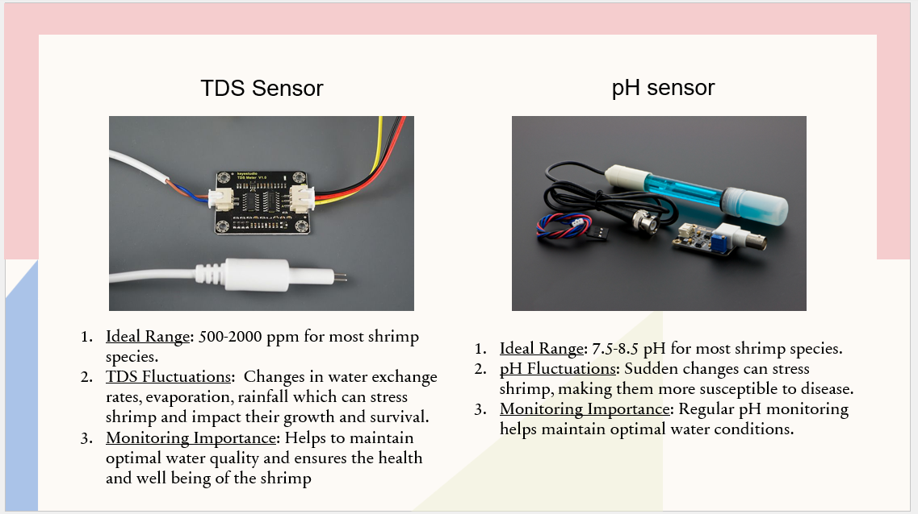

Slide 2
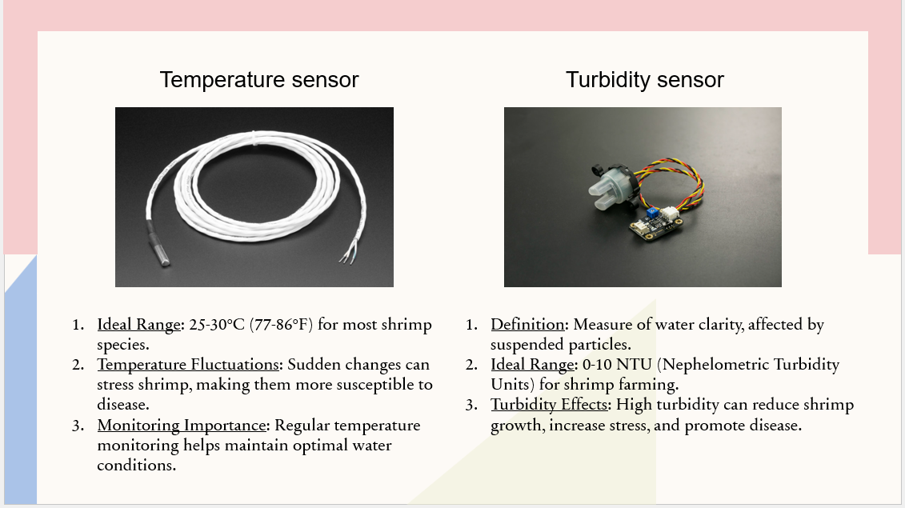

Slide 3
Sensor Selection List
Sensor | Parameter Monitored | Reason
pH Sensor | Acidity/Alkalinity | Shrimp require stable pH (7.5 – 8.5) for healthy growth
Temperature Sensor | Water Temperature | Impacts shrimp metabolism and dissolved oxygen
TDS Sensor | Total Dissolved Solids | Indicated salinity and mineral concentration
Turbidity Sensor | Water Quality | High turbidity indicates waste buildup and poor quality
Justification
These sensors monitor the most critical environmental conditions that affect shrimp survival, growth rate, and disease prevention. Continuous monitoring helps farmers take preventive action before water conditions become harmful.

